Slide 1
Team 516
Lunar Dust Glovebox
Design Review 5
February 25, 2025
Notes:
Good afternoon everyone, We are Team 516 and today we will be talking about our design and progress for the Lunar Dust Glovebox Project

Slide 2
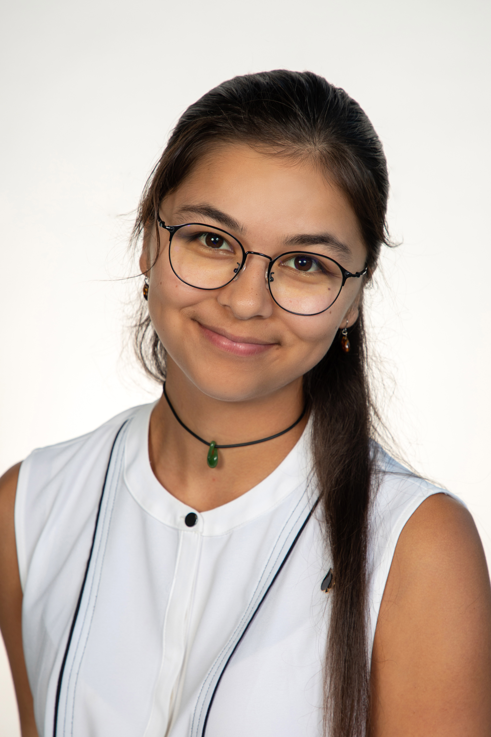

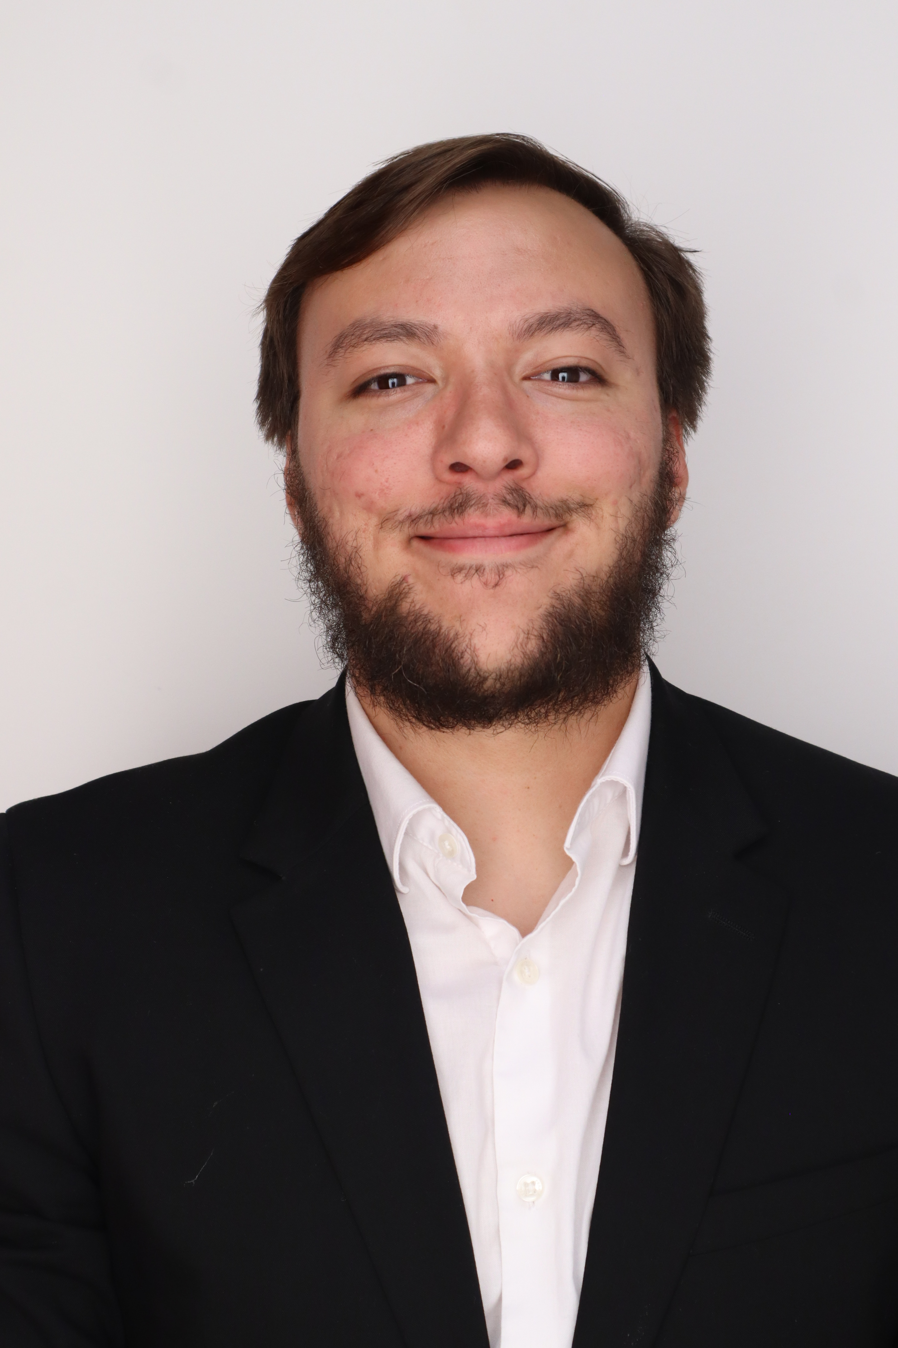
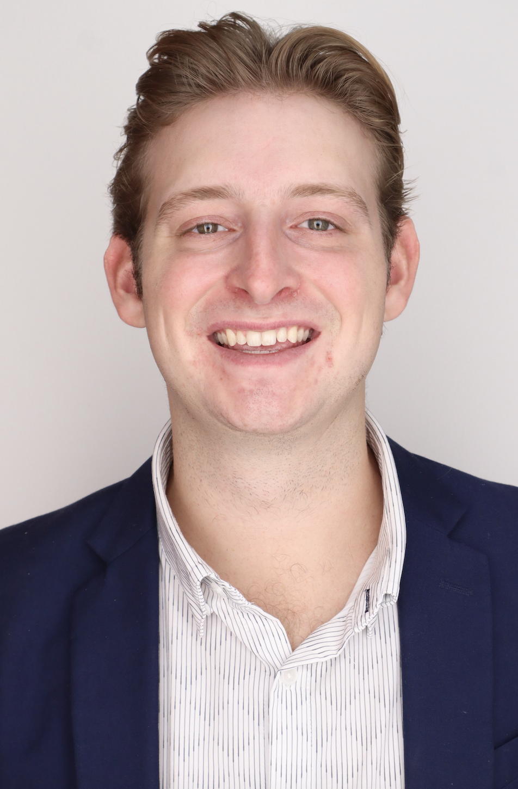

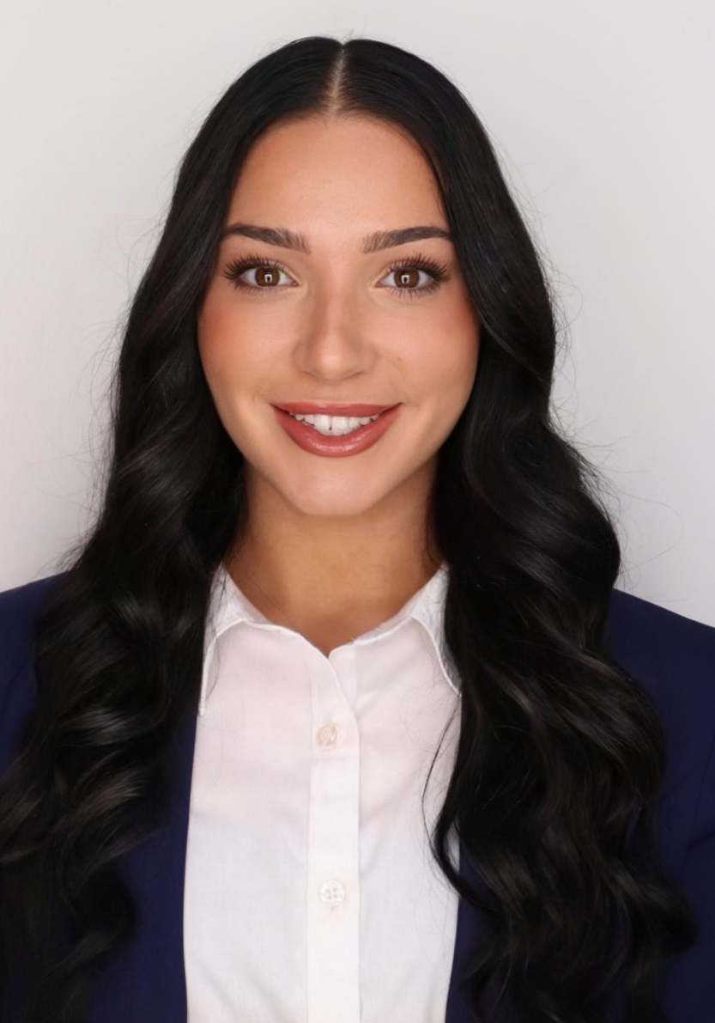
Our Team
All
Presenter
Presenter
Nia Britton
Manufacturer
Kendall Kovacs
Simulant Specialist
Lawrence Terrell
CFD Analyst
Presenter
Mina Brahmbhatt
Manufacturer
Ryan Dreibelbis
CFD Analyst
Peter Mougey
Manufacturer
2
Notes:
Im mina, im nia, im ryna, im kendall, im peter, and im lawrence

Slide 3
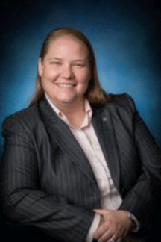
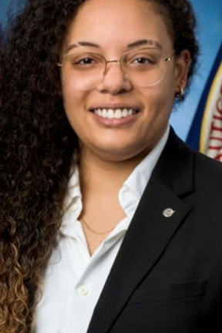
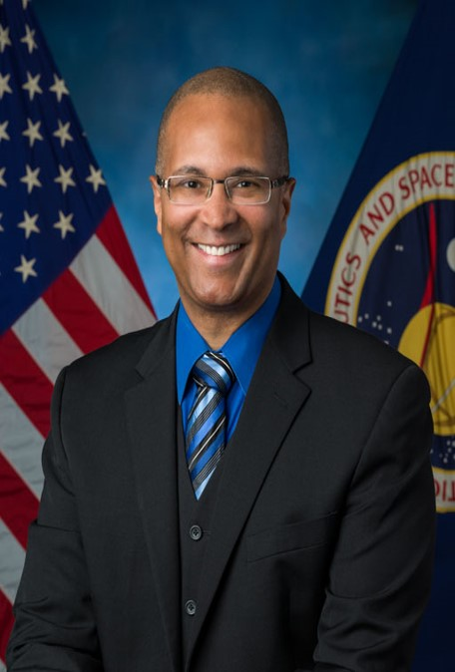
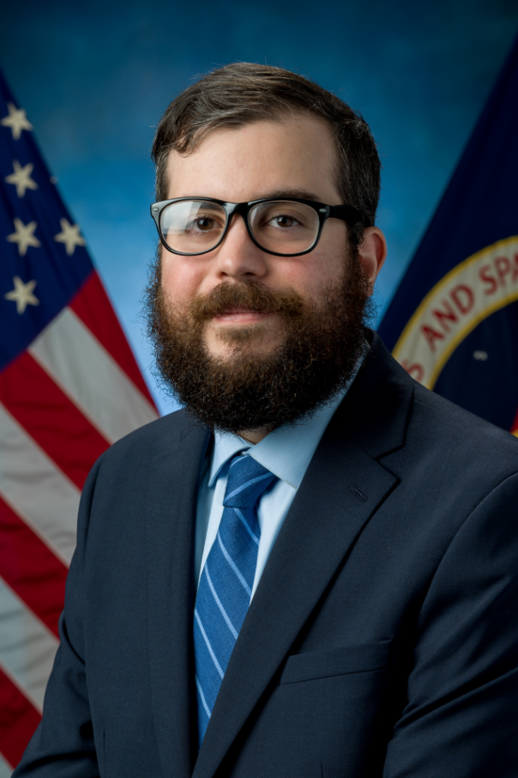
Sponsors
Kendall Kovacs
Amy Cassady
Orion Integrated Performance Lead
Amy Fritz
JSC Dust Mitigation Technical Lead
Brian Troutman
Human Landing System Crew Compartment Lunar Dust Mitigation Discipline Lead
Thomas Vassiliou
EX2 Spacecraft Performance and Concept Engineering (SPACE) Acting Deputy Branch Chief
Notes:
Here are our sponsors, both the Amy’s, brian (our main point of contact) and thomas

Slide 4
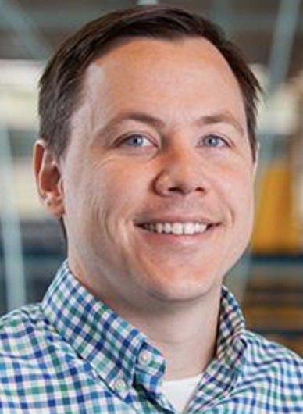

Advisors
Kendall Kovacs
Dr. Brandon Krick Associate Professor
Dr. Shayne McConomy
Teaching Faculty II
Notes:
And here are our advisor, both dr krick and dr mcconomy

Slide 5


Objective
Kendall Kovacs
The objective of this project is to optimize air flow to evenly distribute lunar dust simulant throughout a lunar dust glovebox.
Notes:
The objective of our project is pretty straightforward, to optimize air flow to evenly distribute lunar dust simulant throughout a lunar dust glovebox

Slide 6
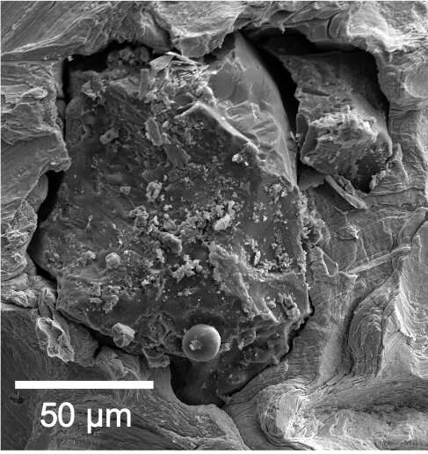
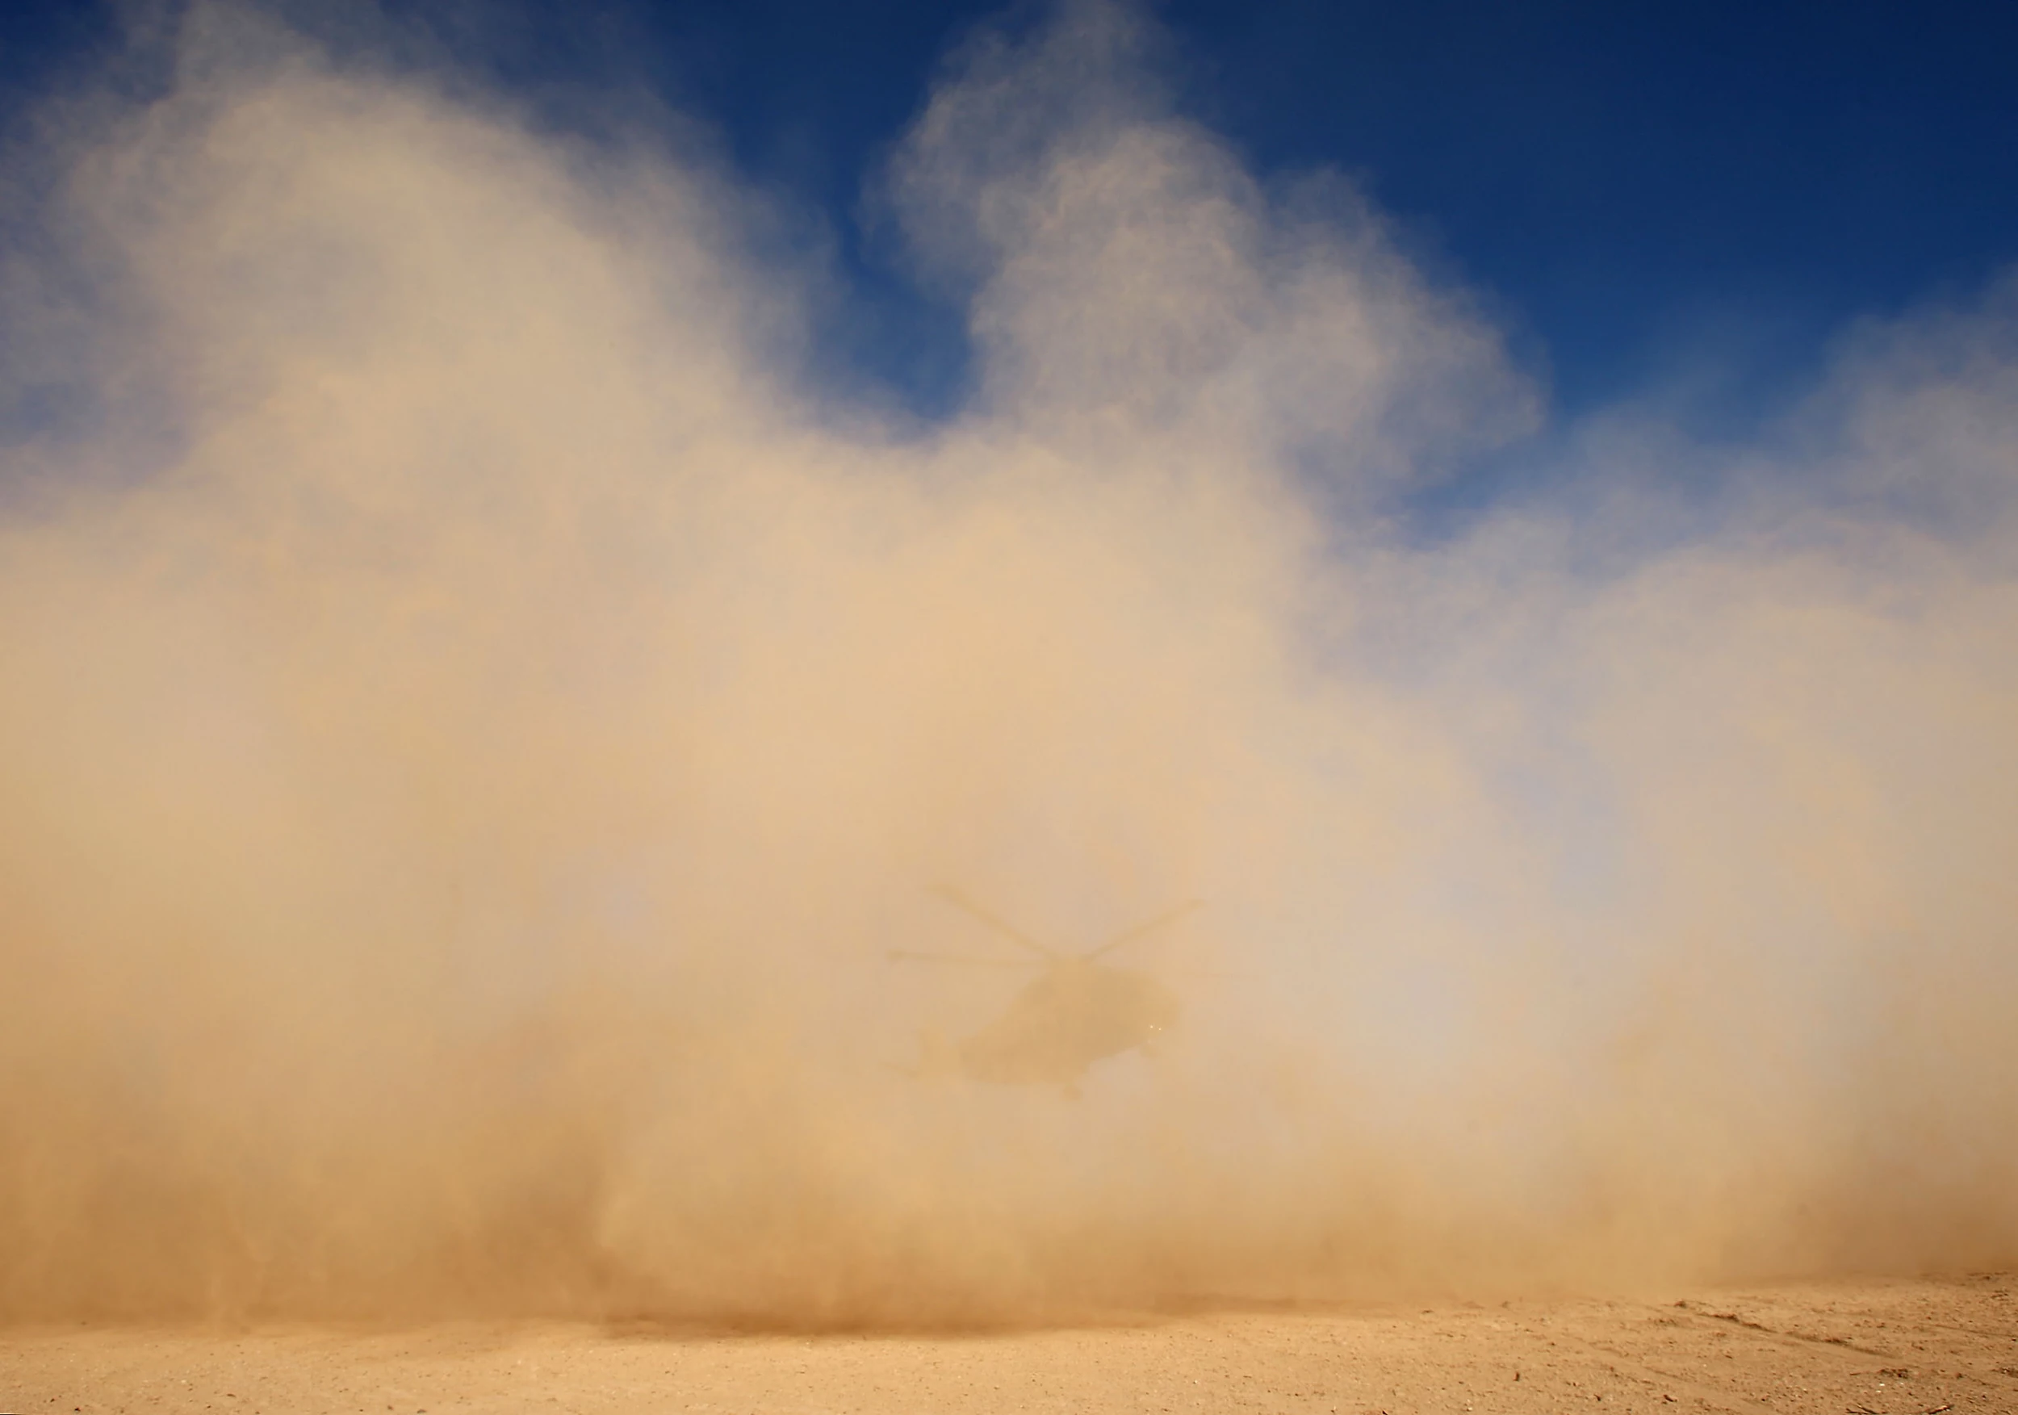
Project Background:
Lunar Dust
Kendall Kovacs
Fine particles of the lunar surface
Average size: ~100 µm
  Human hair: 17-181 µm
Average bulk density: 1.5 g/cm³
Dust cloud
Lunar dust microstructure
Notes:
The particles jagged edges and irregular shape is what leads to it being so harmful to mechanisms and humans. These particles can be very fine, with an average size of around 100 nanometers and bulk density of one point five grams per centimeter cubed

Slide 7
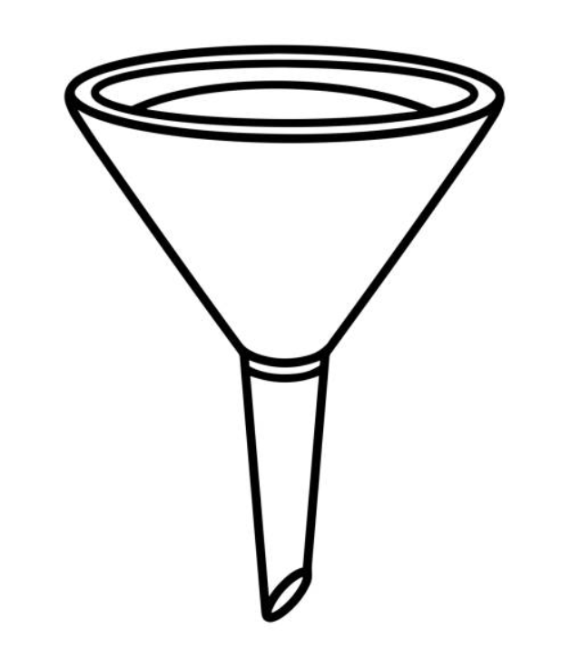

Project Background:
The Problem
Kendall Kovacs

Slide 8
Project Background:
The Problem
Kendall Kovacs

Slide 9


Project Background:
Overall Goals
Kendall Kovacs
Model air flow using CFD
Design and test glovebox design
Compare result with CFD

Slide 10
Selected Simulant:
Characteristics
Kendall Kovacs
LHS-1D:
Lunar Highlands Dust Moon Simulant
LHS-1D:
Lunar Highlands Dust Moon Simulant
Run #1
200 g
Run #2
400 g
Order Size: 1000g
Particle size range: <35 µm
Uncompressed bulk density: 0.79 g/cm³
Mineralogically Accurate
Material Density: 3.16 g/ cm³
Notes:
-Highlands is from the lighter part of the moon
-Mare is from the darker side of the moon
-Chose these because they fit the criteria for density needs (below 35 um) and they both come from the same company called Space Resource Technology
-IF ASKED: since we switched from LHS-1 to LHS-1D, the difference is a smaller particle diameter of 35 microns compared to 1 mm
- Trying to figure out what the optimal lofting amount is to where we can see it and make observatikons but also it will loft easily

Slide 11
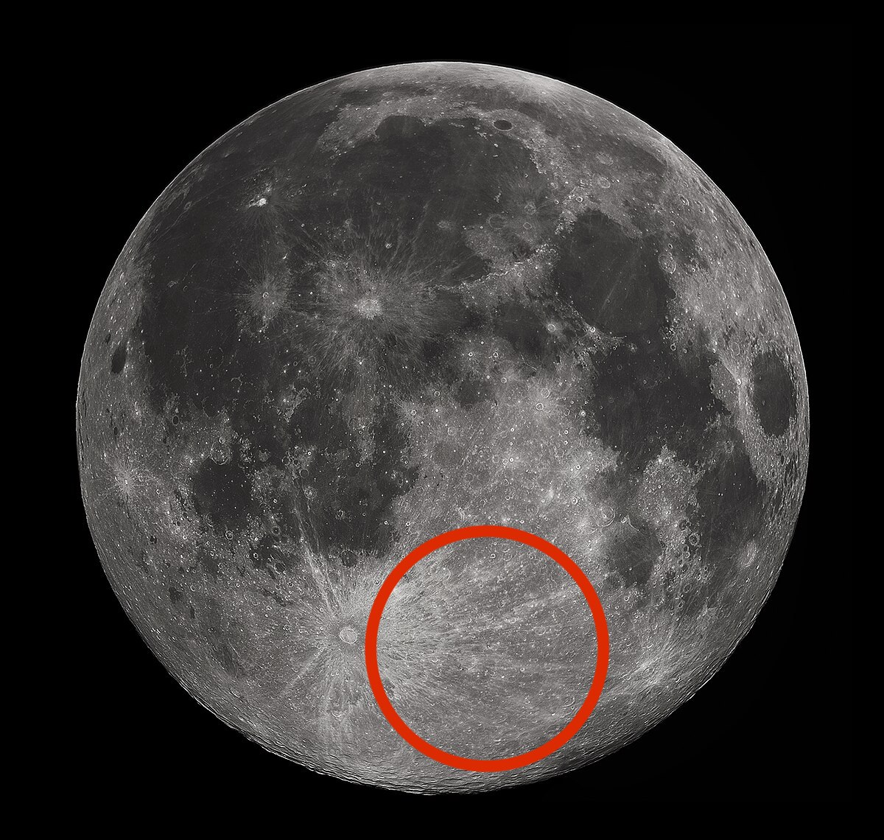
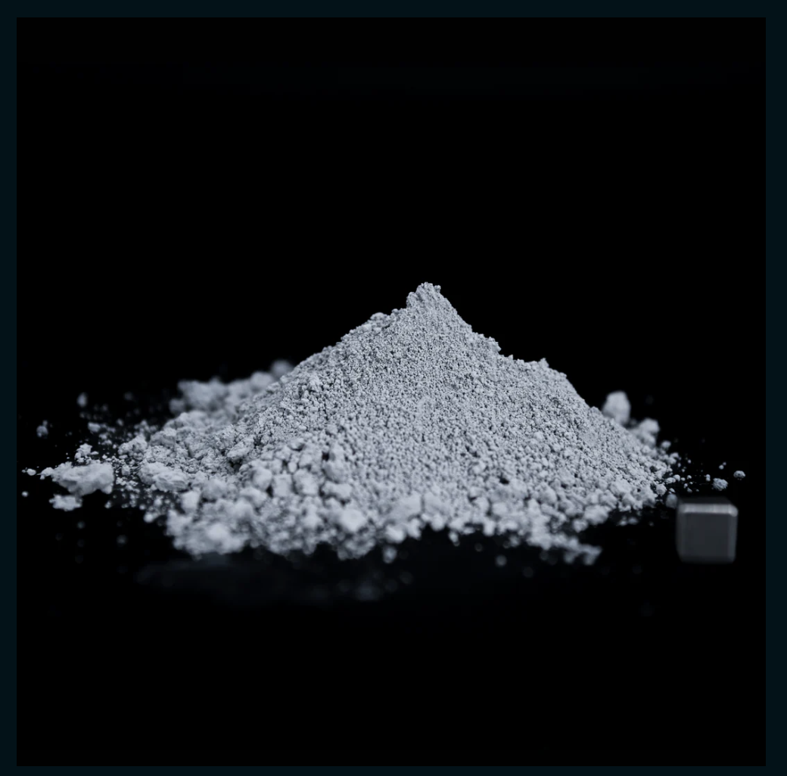
Selected Simulant:
Characteristics
Kendall Kovacs
LHS-1D:
Lunar Highlands Dust Moon Simulant
LMS-1:
Lunar Mare Dust Moon Simulant
Highlands of the moon
LHS-1D Lunar Dust Simulant
Notes:
-Highlands is from the lighter part of the moon: mainly anorthsite formed from slowly cooled lava
-Mare is from the darker side of the moon: mainly dark basalts formed from rapid cooled lava
-Chose these because they fit the criteria for density needs (below 35 um) and they both come from the same company called Space Resource Technology

Slide 12
Selected Simulant:
Impact on Overall Goals
Kendall Kovacs
Shorter processing time
More accurate results
Design and test glovebox design
Better quality control
Reduce error
Compare result with CFD
Corroborate CFD
Alter CFD results
Model air flow using CFD
Notes:
More likely to achieve goals if we focus on modeling one simulant with specific density and particle size distribution and corresponding fluorescent spheres and editing that CFD model, fiuring out particle size distribution for only one so it can be more accurate, doing quality control on only one simulant

Slide 13
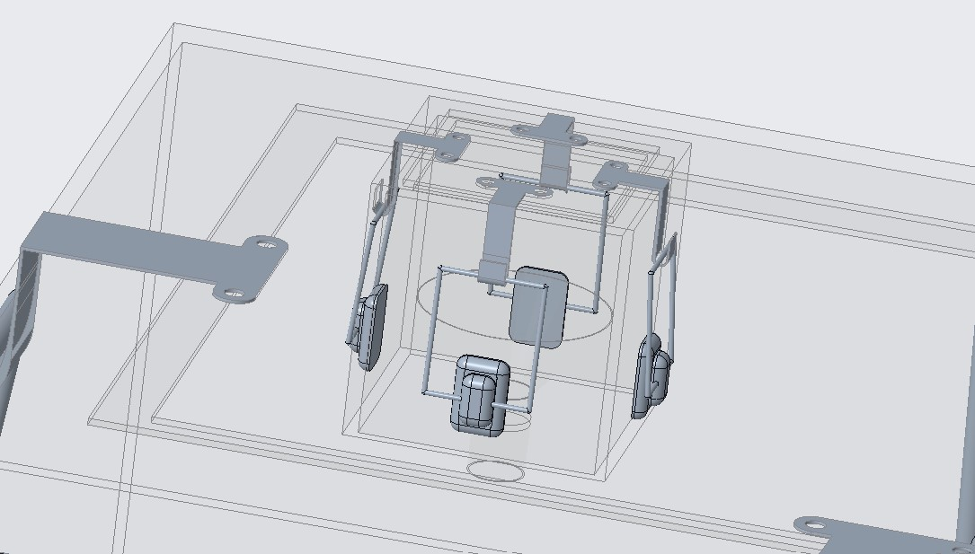
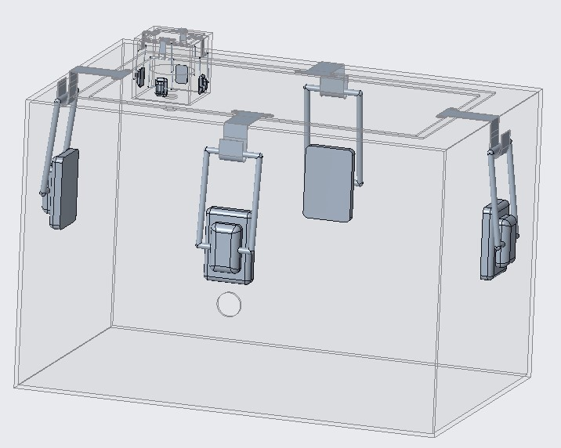
Design Concept:
CAD Model
Mina Brahmbhatt
Notes:
Here is a final draft of the glovebox design we want the machine shop to craft for us, with a spot for vacuum testing, a main box enclosure, a funnel enclosure, and latches to secure the tops
Here is a final draft of the glovebox design we want the machine shop to craft for us, with a spot for vacuum testing, a main box enclosure, a funnel enclosure, and latches to secure the tops
Taalk about four latches securing the main body top and four securing the funnel enclosure top
Maybe a possible rubber insert in the circle of the funnel portiong for the funnel stopper to push down
Main body 24 x 24 x 36 inches
Funnel enclosure 4 x 4 x 4 inches
Funnel built into box
Main body top and funnel enclosure top both completely removable
Both sandwiched with rubber gasket material
8 latches total
Funnel insert from funnel enclosure top
Secure funnel stopper

Slide 14
Design Concept:
Fan Mount
Mina Brahmbhatt
Heavy Duty Suction Cups
CPU fan
Glovebox Wall
-Lexan polycarbonate
-0.25 inch thick
Shaft
Pivot-Joint
Notes:
Here is a final draft of the glovebox design we want the machine shop to craft for us, with a spot for vacuum testing, a main box enclosure, a funnel enclosure, and latches to secure the tops
Taalk about four latches securing the main body top and four securing the funnel enclosure top
Maybe a possible rubber insert in the circle of the funnel portiong for the funnel stopper to push down
Main body 24 x 24 x 36 inches
Funnel enclosure 4 x 4 x 4 inches
Funnel built into box
Main body top and funnel enclosure top both completely removable
Both sandwiched with rubber gasket material
8 latches total
Funnel insert from funnel enclosure top
Secure funnel stopper

Slide 15
Design Concept:
Fan Mount
Mina Brahmbhatt
Heavy Duty Suction Cups
CPU fan
Glovebox Wall
-Lexan polycarbonate
-0.25 inch thick
Shaft
Pivot-Joint
Notes:
Here is a final draft of the glovebox design we want the machine shop to craft for us, with a spot for vacuum testing, a main box enclosure, a funnel enclosure, and latches to secure the tops
Taalk about four latches securing the main body top and four securing the funnel enclosure top
Maybe a possible rubber insert in the circle of the funnel portiong for the funnel stopper to push down
Main body 24 x 24 x 36 inches
Funnel enclosure 4 x 4 x 4 inches
Funnel built into box
Main body top and funnel enclosure top both completely removable
Both sandwiched with rubber gasket material
8 latches total
Funnel insert from funnel enclosure top
Secure funnel stopper

Slide 16
Design Concept:
Fan Mount
Mina Brahmbhatt
Heavy Duty Suction Cups
CPU fan
Glovebox Wall
-Lexan polycarbonate
-0.25 inch thick
Shaft
Pivot-Joint
Notes:
Here is a final draft of the glovebox design we want the machine shop to craft for us, with a spot for vacuum testing, a main box enclosure, a funnel enclosure, and latches to secure the tops
Taalk about four latches securing the main body top and four securing the funnel enclosure top
Maybe a possible rubber insert in the circle of the funnel portiong for the funnel stopper to push down
Main body 24 x 24 x 36 inches
Funnel enclosure 4 x 4 x 4 inches
Funnel built into box
Main body top and funnel enclosure top both completely removable
Both sandwiched with rubber gasket material
8 latches total
Funnel insert from funnel enclosure top
Secure funnel stopper

Slide 17
Design Concept:
Fan Mount
Mina Brahmbhatt
Heavy Duty Suction Cups
180°
Glovebox Wall
-Lexan polycarbonate
-0.25 inch thick
Pivot-Joint
Shaft
Notes:
Here is a final draft of the glovebox design we want the machine shop to craft for us, with a spot for vacuum testing, a main box enclosure, a funnel enclosure, and latches to secure the tops
Taalk about four latches securing the main body top and four securing the funnel enclosure top
Maybe a possible rubber insert in the circle of the funnel portiong for the funnel stopper to push down
Main body 24 x 24 x 36 inches
Funnel enclosure 4 x 4 x 4 inches
Funnel built into box
Main body top and funnel enclosure top both completely removable
Both sandwiched with rubber gasket material
8 latches total
Funnel insert from funnel enclosure top
Secure funnel stopper

Slide 18

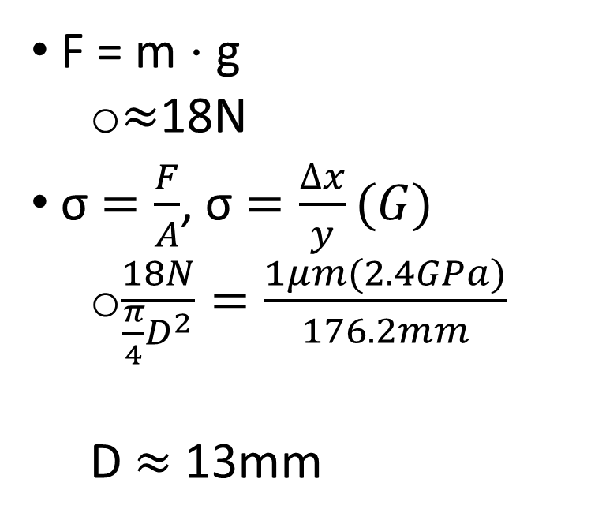
Design Concept:
Shaft Diameter Calculations
Mina Brahmbhatt
F = m ⋅ g
  $≈$18N
σ $=\frac{F}{A}$, σ $=\frac{∆x}{y}(G)$
  $\frac{18N}{\frac{π}{4}D^{2}}=\frac{1μm(2.4GPa)}{176.2mm}$
  D $≈$ 13mm
176.2mm
F
Notes:
Total Length = length of (shaft + pivot joint + fan + suction cup)
= 76.2mm + 63.2mm + 25mm + 25mm
= 176.2mm
Total Mass = mass of (shaft + pivot joint + fan + suction cup + shaft base)
= 150g + 793.8g + 100g + 500g + 277.5g
= 1.8213kg

Slide 19
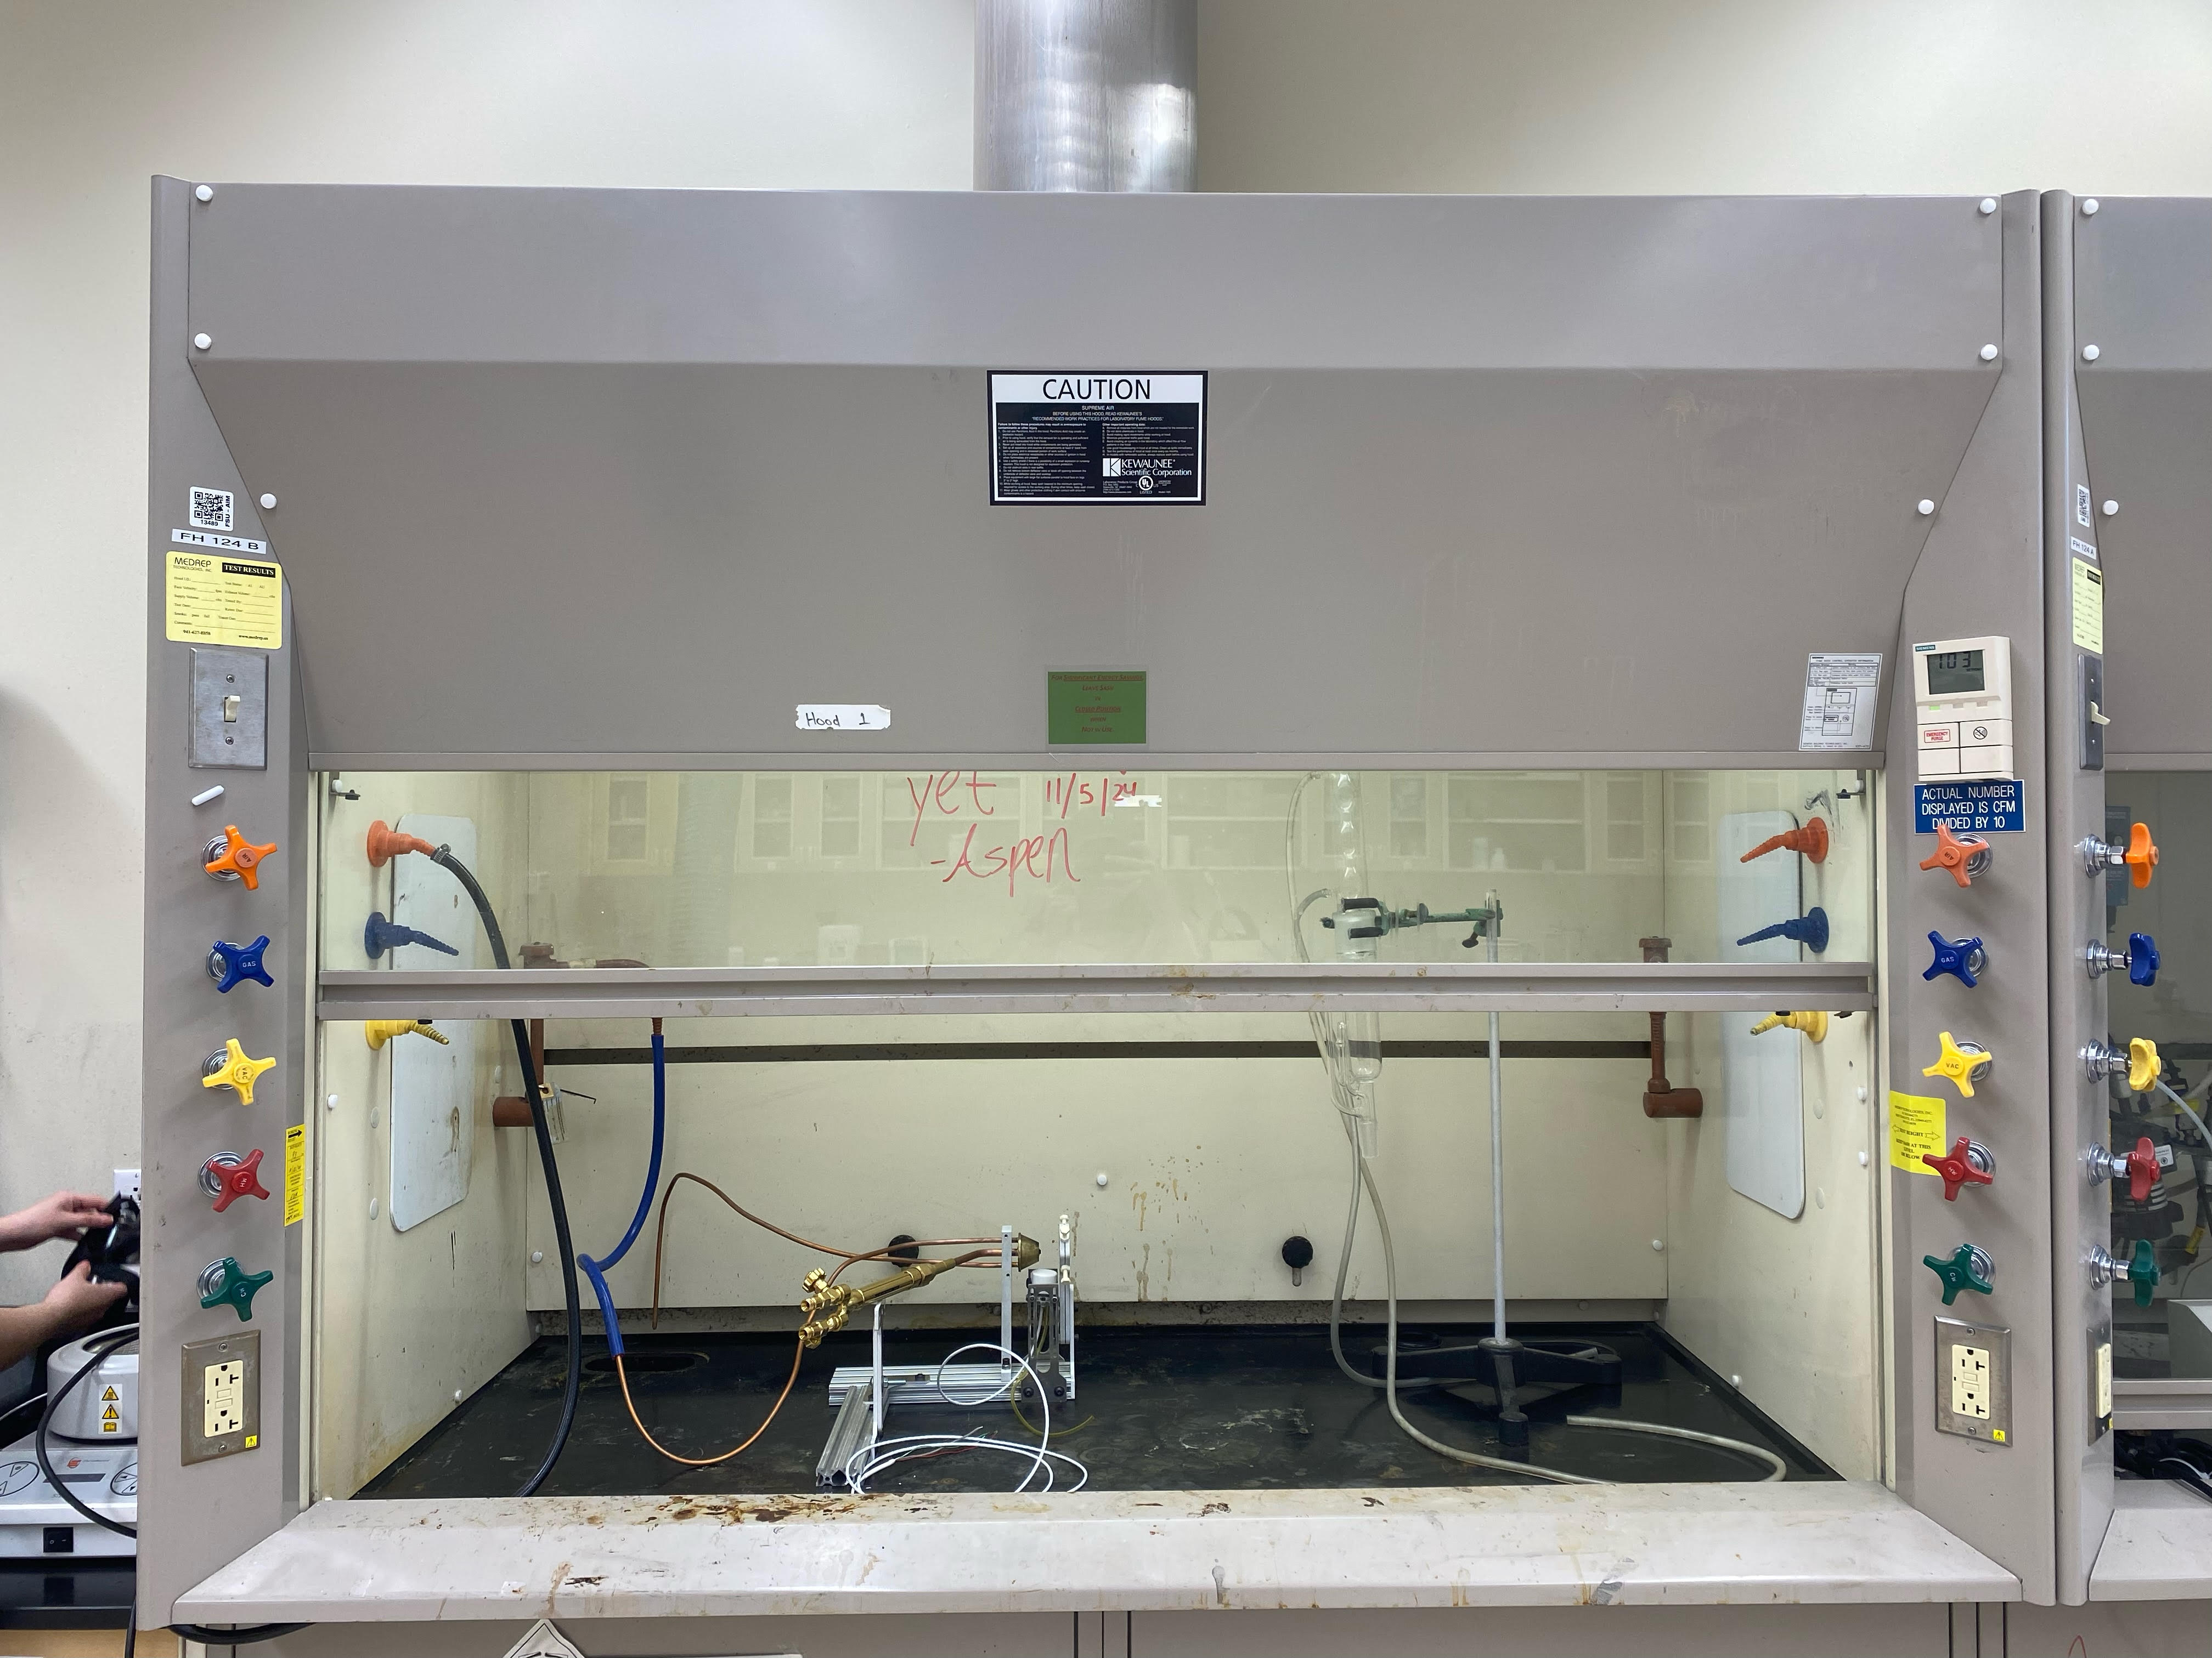
Experiment Details:
Preparation & Set Up
Mina Brahmbhatt
Fumehood use
Reduce inhalation risks
Remove any aerosolized particles
Camera set up
Captures entire box
1.37 m from box
iPhone raised 23 cm from ground
UV light set up
Left
Fans set up
7.6 cm from wall
Adjustable angles
Controlled velocity
Outside facing inward
Fumehood Room 124 at HPMI
Notes:
EXPLAIN WHY THESE DIMENSIONS ARE THE WAY THEY. ARE
200 degrees celsius is empirical based on NASA research
Can bake it out and do pre and post mass calculations and see how mass changes with 15 hours vs 12 butwont be super different.
Baking wont change bulk density a lot bc maybe 1% water in materials. If 10% water then ye sit would change it
Fumehood use
Reduce inhalation risks
Remove any aerosolized particles
Camera set up
Captures entire box
4.5 feet from box
iPhone raised 9 inches from ground
UV light set up
Left, outside facing inward
Fans set up
3 inch from wall
Adjustable angles
Controlled velocity

Slide 20
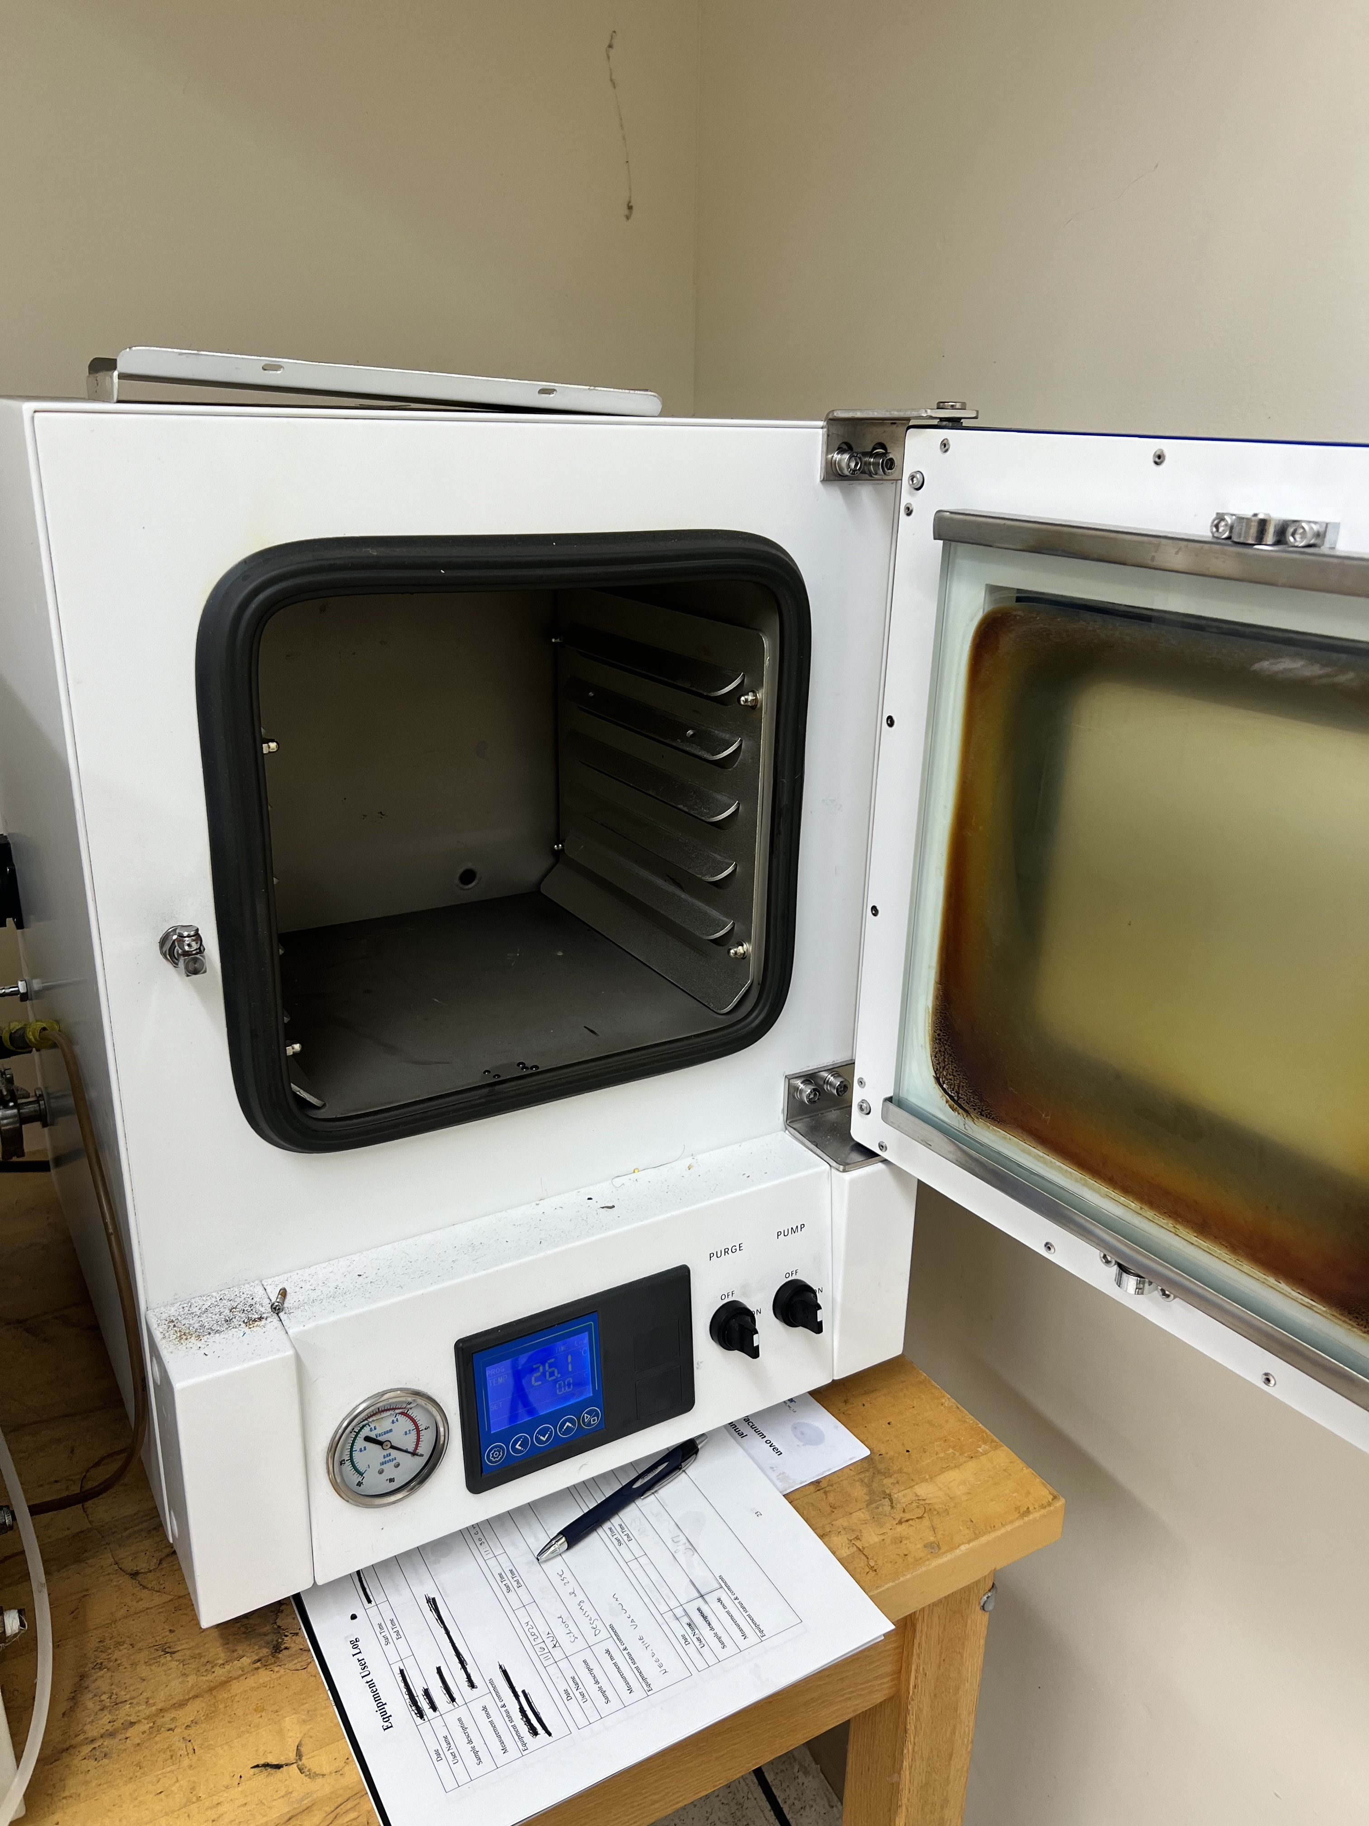
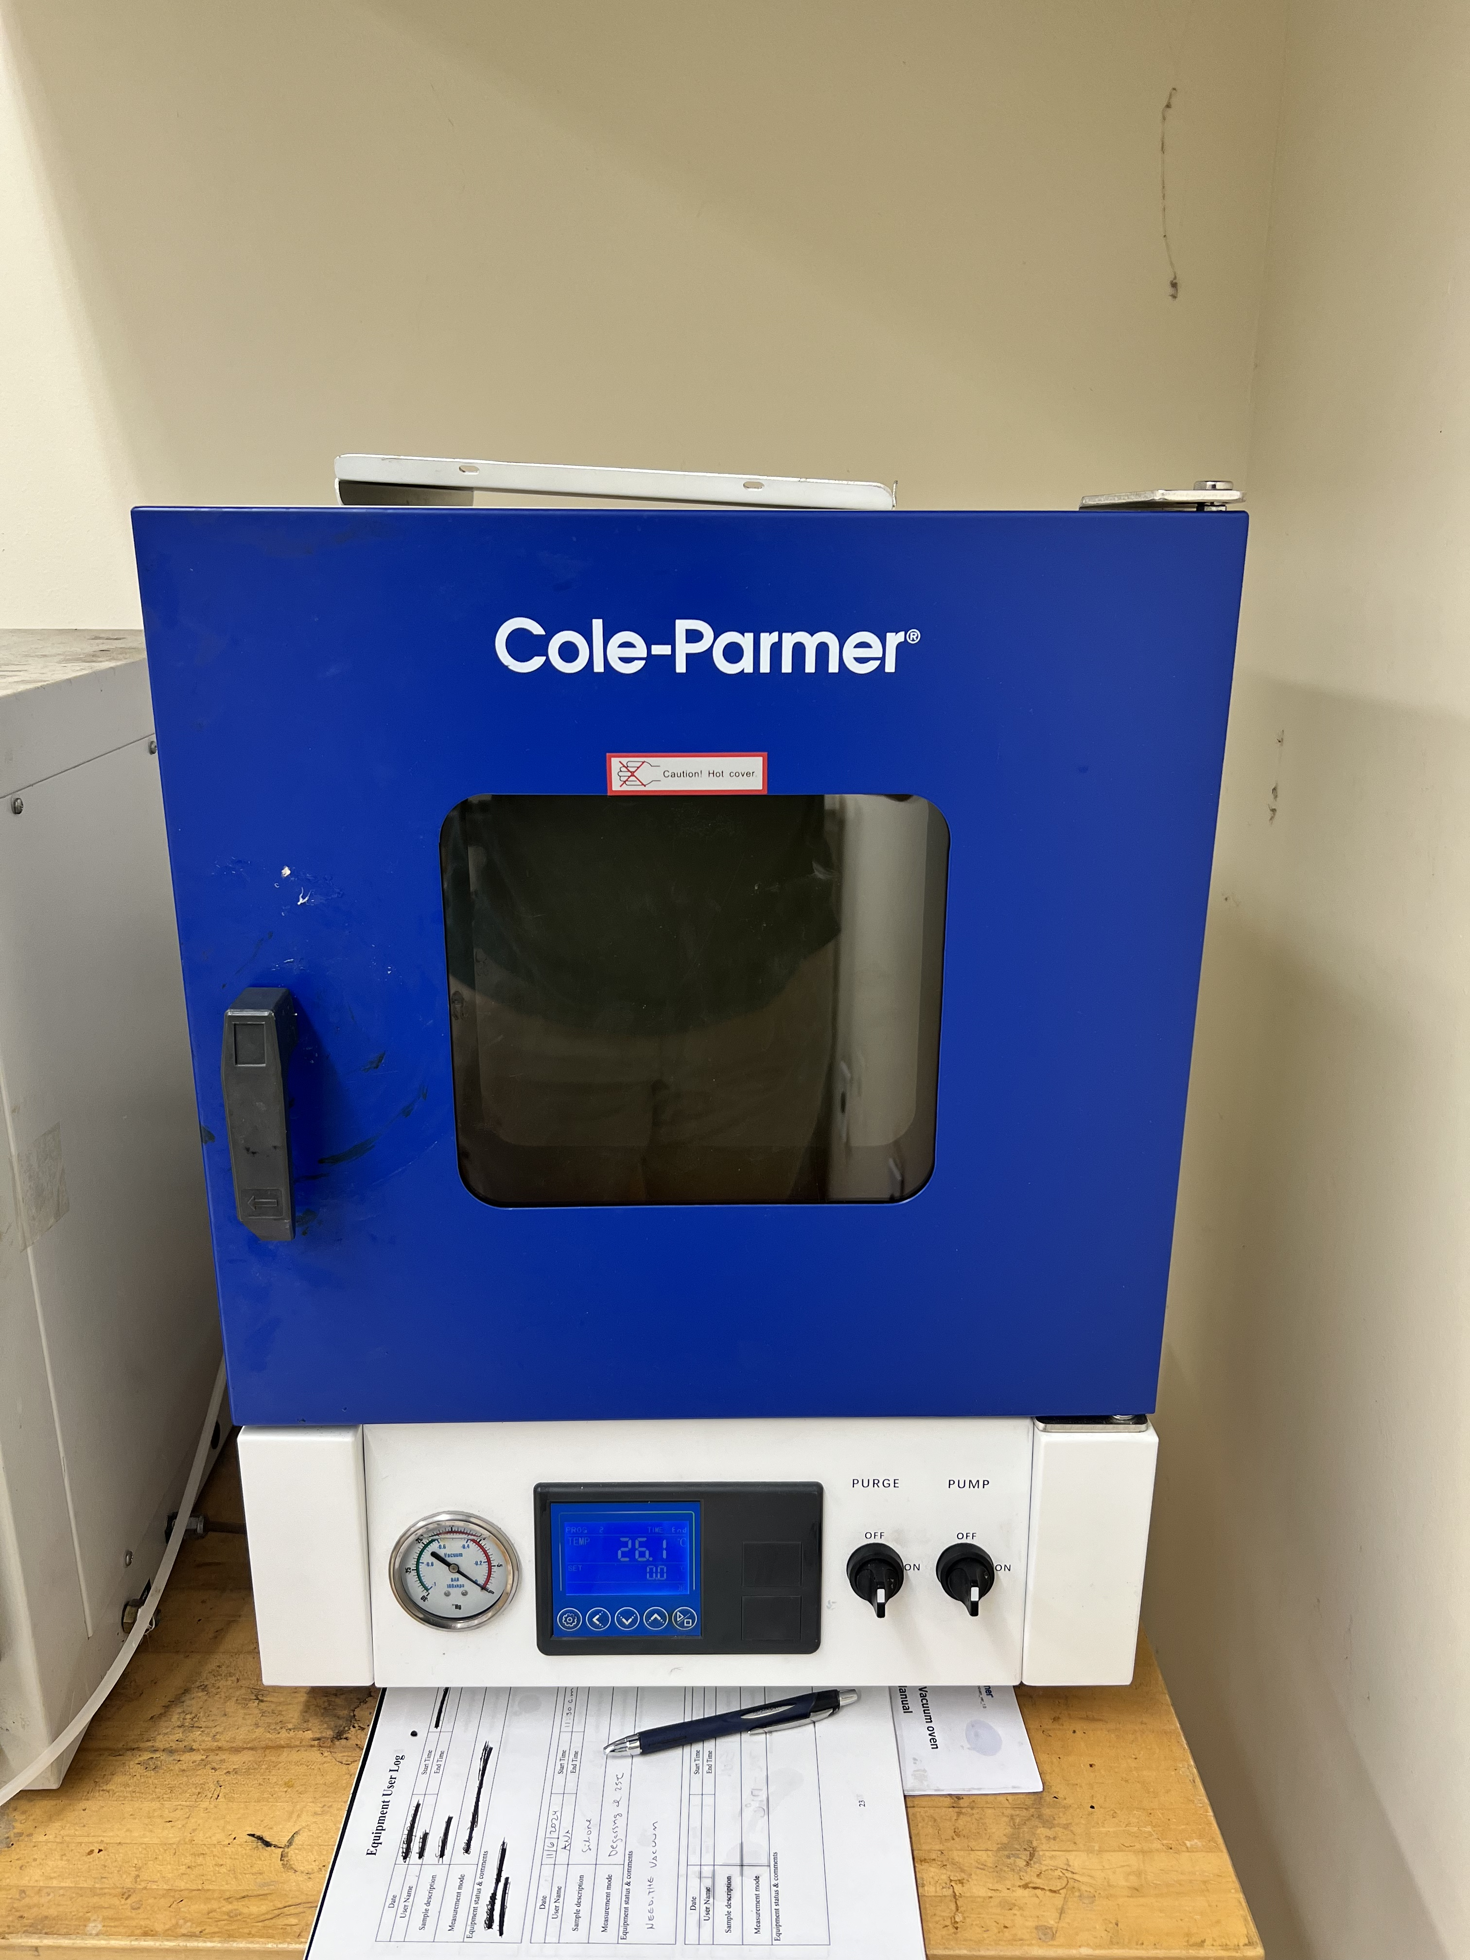
Experiment Details:
Preparation & Set Up
Mina Brahmbhatt
Dehydrating simulant in ovens
Proper safety​ equipment
Begin with dust settle​d
Disposal and cleaning​
Room 124 at HPMI - Dehydrating Simulant
Notes:
200 degrees celsius is empirical based on NASA research
Plans to bake first batch March 3rd – 4th
First test run March 4th
Dehydrating simulant in ovens
12 hours
200 degrees C
Safety​ ez
Goggles, lab coats, N95 masks, and gloves​
Placing box in fume hood​
Starting with dust settle​
Disposal and cleaning​
Wipe between runs​
Wet materials for safer disposal
The 12 hours and 200 degrees cel are empirical from nasa research. This is in order to get all the water from all the porous surfaces within the particles. 100 degrees will not dehydrate the simulant like we need it too, and the drying process we plan to use will only change the density by 1 percent
NASA looked at mass loss in the material and how much changes. 200 is just what they have been empirically able to show works. Higher than 200 would alter the materials in there. No clay on lunar surface bc no water on lunar surface. So ideally want simulants that don’t have clay bc bc theyre on earth theyre exposed to water so they have clay minerals exposed which is not ideal and we dont want them there but are still there no matter what we do. When we bake at higher temperatures, those clay minerals are first thing that start to change. When we bake it gets them to the version out that we dont want but not too much to where they alter. 200 is in between value that gets that water out and takes some of clay out but not too much to where it alters way too much. Lower wouldnt get all surface bound water out. Might be intraporous spaces filled with water that will come to surface, so want to bake it out. 100 degrees will not be sufficient to do that. Doesn't have to be exactly 12 hours, they sort of just do overnight sort of thing where they leave materials overnight in oven and let it bake itself out.
Can bake it out and do pre and post mass calculations and see how mass changes with 15 hours vs 12 butwont be super different.
Baking wont change bulk density a lot bc maybe 1% water in materials. If 10% water then ye sit would change it

Slide 21
Experiment Details:
UV Light Visualization
Ryan Dreibelbis
Notes:
-explain that these are hard to see with the naked eye
-click next slide so they shrink

Slide 22
Experiment Details:
UV Light Visualization
Ryan Dreibelbis
Notes:
So in order to visualize how the lunar simulant is moving the glovebox, fluorescent beads and UV light will be used. (move to next slide)

Slide 23

Experiment Details:
UV Light Visualization
Ryan Dreibelbis

Slide 24

Experimental Details:
Photography & Image Analysis
Ryan Dreibelbis
Notes:
Video footage will be taken of the glovebox while it is being tested. The glove box will be split into sections. (move to next slides)

Slide 25
Experimental Details:
Photography & Image Analysis
Ryan Dreibelbis

Slide 26
Experimental Details:
Photography & Image Analysis
Ryan Dreibelbis
2
2
2
2
2
2
2
2
Notes:
Fluorescent beads inside will be analyzed by sections of the glovebox through image analysis

Slide 27
Experimental Details:
Photography & Image Analysis
Ryan Dreibelbis
2
2
2
2
Evenly Distributed
2
2
2
2
Notes:
If the quantity of fluorescent beads in each section of the box are similar then the lunar simulant can be considered evenly distributed.

Slide 28
Experimental Details:
Testing and Prototype Challenges
Mina Brahmbhatt
Challenge 1:
Challenge 2:
Challenge 3:
Vacuum testing prototype post build
  Exceeding PSI limits
  Leakage security
  Rechecking after any new entry points are introduced
Preventing leakage into funnel enclosure
  Funnel stopper
  Sealing off all screw and wire entry points
  Using rubber gasket material to create seal for tops
Post processing route
  No longer considering particle image velocimetry
  ImageJ
  Apple Pro Raw Images
Notes:
Preventing leaks is of paramount importance both to the success of the project as well as the safety of Team 516. Our first challenge regarding leakages will be vacuum testing the prototype after it has been built and being sure it does not exceed PSI limits. The second challenge regarding leakages discuss preventing material getting inside the funnel enclosure, which we plan to address by using a funnel stopper. Lastly, we are no longer planning to use PIV as our means of post processing, and are instead looking more towards image analysis tools such as ImageJ or Apple Pro Raw.

Slide 29
Preliminary CFD:
Force Calculations
Lawrence Terrell
Particle will loft when the drag force acting on the particle is greater than its weight.
A fan velocity as low as 0.5 m/s will cause the particle to loft
Number of individual particles give insight on the modeling complexity in a virtual simulation.
Density of simulant = 3.16 g/cc
Volume of simulant = 63.23 ${cm}^{3}$
Volume of simulant = 63.23 〖𝑐𝑚〗^3
Number of particles in 200g of simulant = 3.52$×{10}^{11}$
Number of particles in 200g of simulant = 3.52×10^11
Mass of one particle = 5.67$×{10}^{−13} kg$
Mass of one particle = 5.67×10^(−13) kg
Weight of one particle = $5.57×{10}^{−12} N$
Weight of one particle = 5.57×10^(−12) 𝑁
Velocity of fan = 2.57 m/s
Drag force on particle = $2.79×{10}^{−11} N$
Drag force on particle = 2.79×10^(−11) N

Slide 30
Simulation Details:
CFD Progress and Analysis
Lawrence Terrell
Steady, multiphase flow achieved using Ansys CFX
Flow comprises of simulant and air at 25°C
Results analysis
Airflow Velocity
Simulant Mass Concentration
Simulating various designs
Fan positions
Fan angles

Slide 31
Simulation Details:
CFD Current Assumptions and Simplifications
Lawrence Terrell
Flow
Fans
Microparticles
Uniformly distributed
Initially settled on glovebox floor
Steady flow
Multiphase flow
No mass inflow/outflow
Does not account for fan mount
Air and simulant particles
25°C
Modeled as velocity inlets
Perfectly spherical

Slide 32
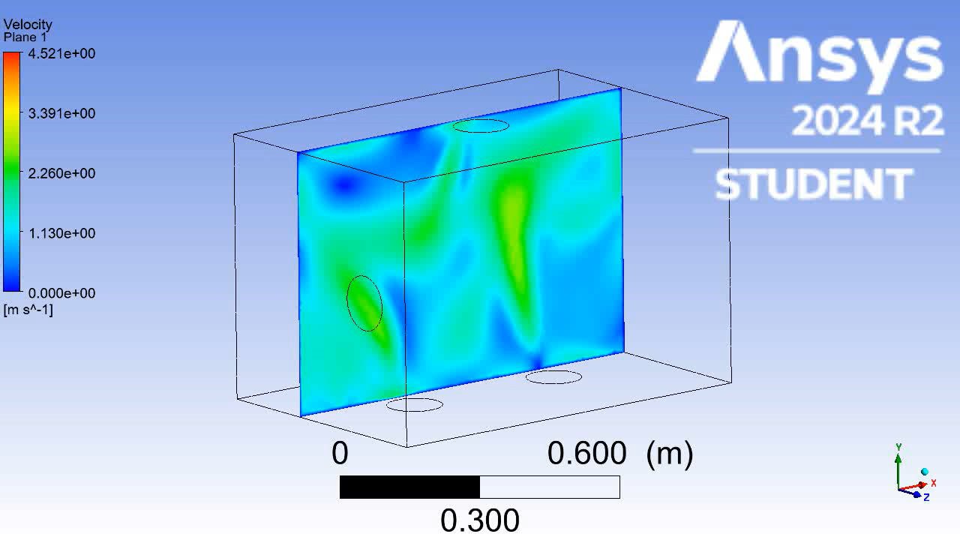
Simulation Results:
Sweep Animation
Lawrence Terrell
Fan Position 2: Velocity Contour Sweep Animation
Notes:
This animation shows the velocity contour throughout the glove box with the second fan position design. In this design the side fans are shifted 6 inches to the right of the center of the side wall, facing perpendicular to the side wall. The velocity contours provide a way to check that the airflow in the simulation is reasonable and thus the simulation was executed properly. The sweep animation can also be utilized to show the simulant mass concentration inside the glove box.

Slide 33
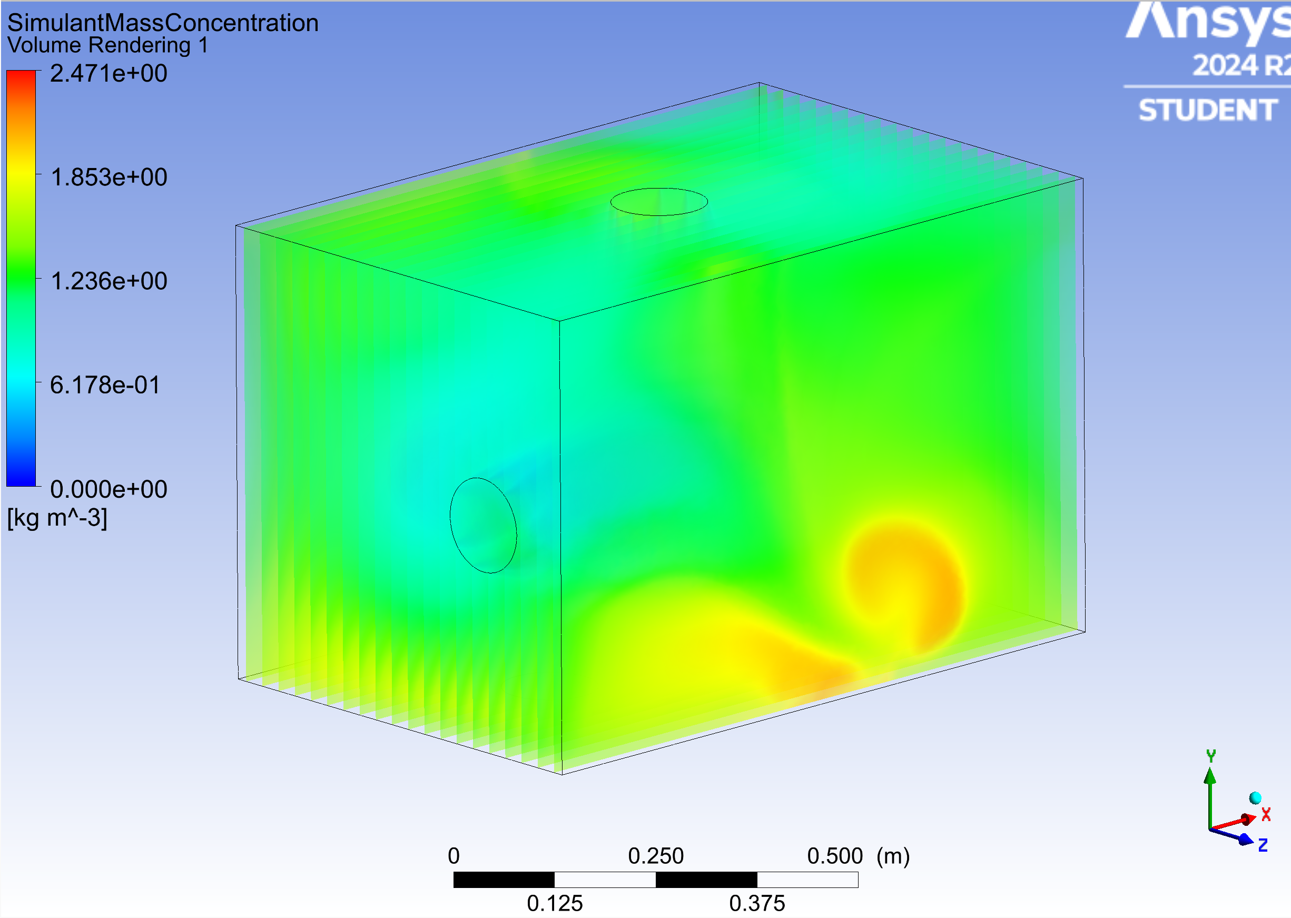
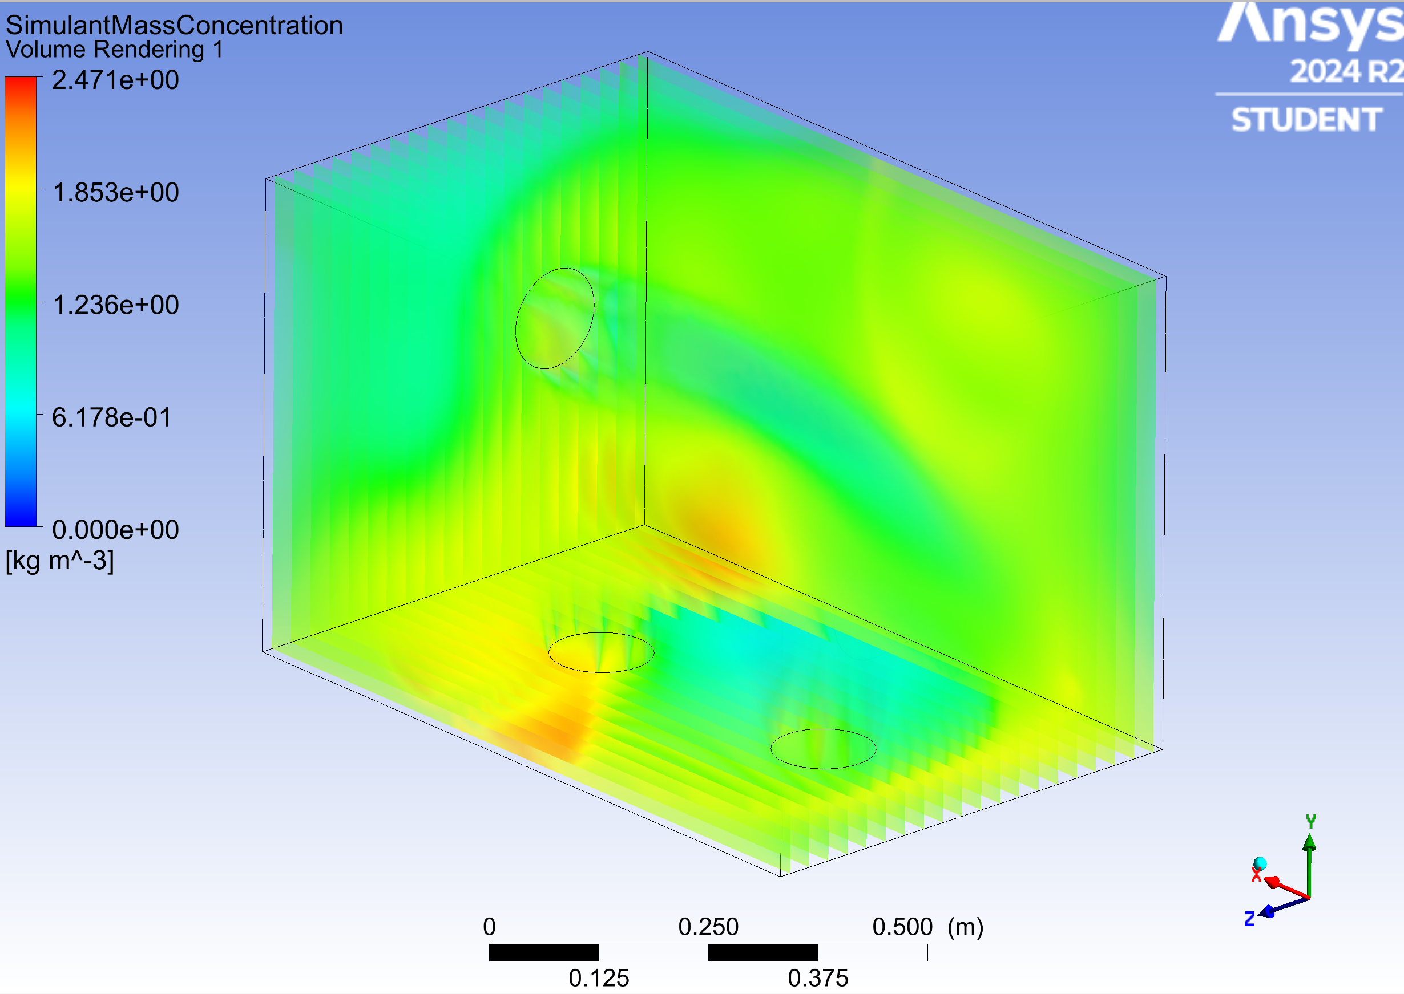
Simulation Results:
Simulant Mass Concentration Volume Rendering
Lawrence Terrell
Fan Position 2: Simulant Mass Concentration Volume Rendering
Front View
Back View
Notes:
These images show the volume rendering for the simulant mass concentration inside the glove box. The results displayed are still for our secondary fan position design where the fans mounted on the side walls are shifted to the right. Volume rendering is a very useful tool in showing the mass concentration for the simulant in the corners, which are areas of concern for our sponsors since that is where the simulant would usually build up in from their previous design. Based on the shown volume rendering, our secondary fan position does not let the simulant build up in the corners of the glove box, but still builds up slightly towards the edges of the glove box.

Slide 34
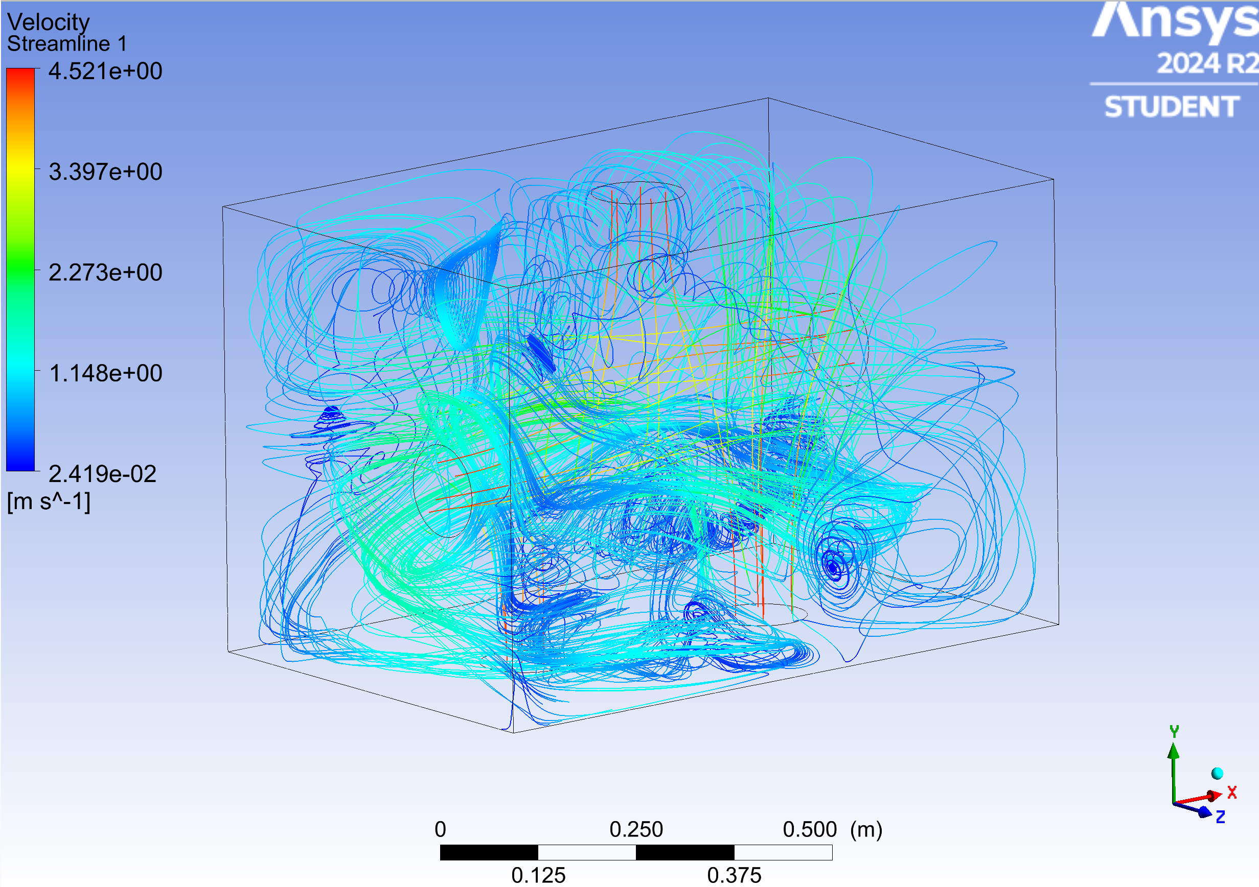
Simulation Results:
Velocity Streamlines
Lawrence Terrell
Fan Position 2: Velocity Streamlines
Notes:
These images show the velocity streamlines for our secondary fan positions design. This illustrates the path that the airflow follows inside the glove box, as well as show the magnitude of the velocity along those streamlines.

Slide 35
Simulation Details:
CFD Challenges
Lawrence Terrell
Decide upon our final fan positions and angles from current data sets and steady state simulations
Develop a transient model of the current simulations
Generating timestep animations of inside the glove box illustrating the motion of the simulant and airflow
Challenge 1:
Challenge 2:
Challenge 3:
Notes:
Our next steps will be to finalize our fan positions and angles based on the steady state simulations and current data sets. From the final design we decide, we will proceed to develop a transient simulation of the glove box. From this transient simulation, we can develop timestep animations showing the inside of the glove box as a progression of time.

Slide 36
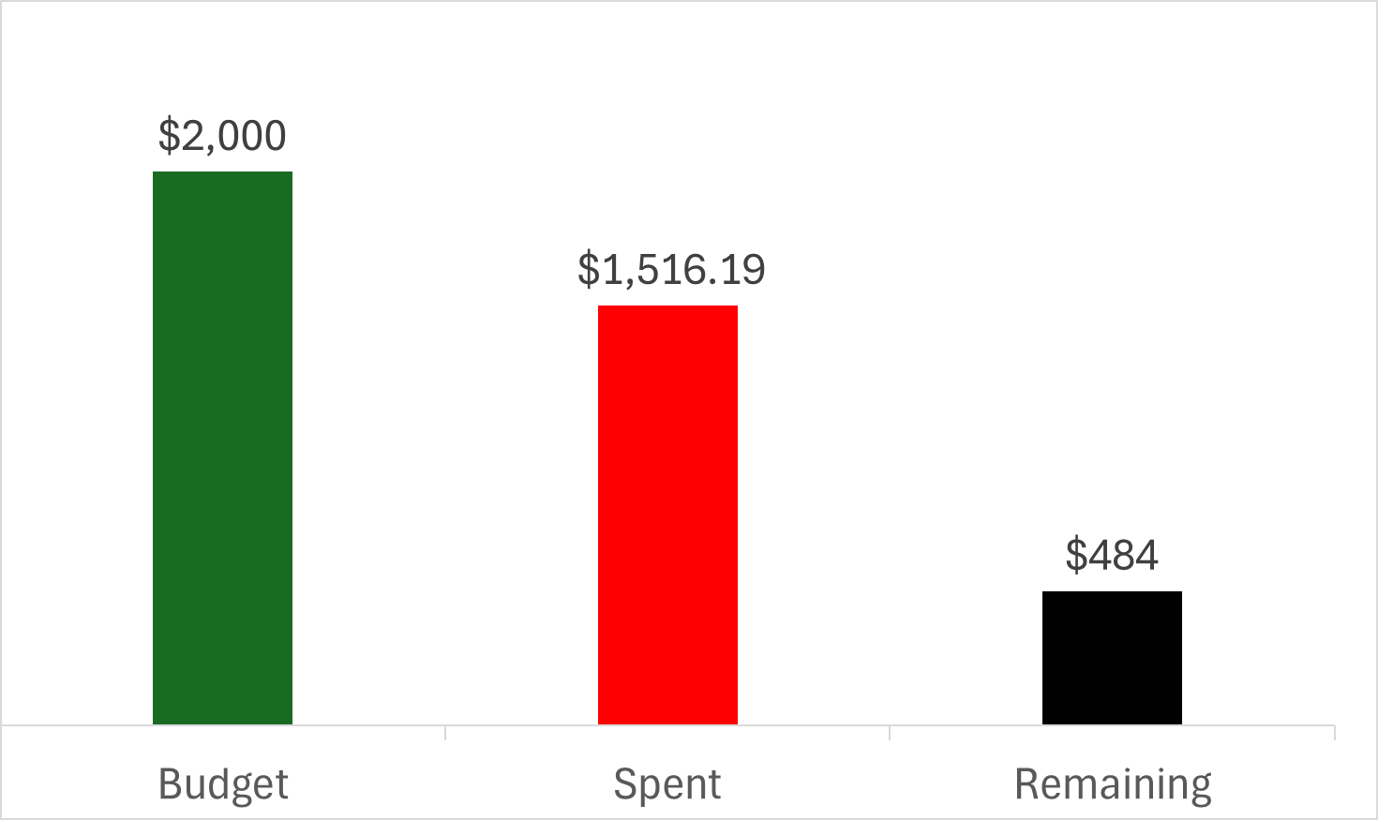
Budget:
Bill of Materials
Kendall Kovacs
2000 dollars allocated
75.81% of budget used
Notes:
This is how much money we plan to use, and fortunately we are just within budget, maximizing our spending efficiency

Slide 37
Future Work
Kendall Kovacs
Materials Inspection
1st Experiment Preparation and Execution
CFD Simulation Finalizations
Work Order Creation for Glovebox
Notes:
For fute work, next we want to have the cfd simulations finalized, wait on our materials to be delivered, create a work order for the machine shop once the materials come in, and prepare for and execute our first experiment run!

Slide 38
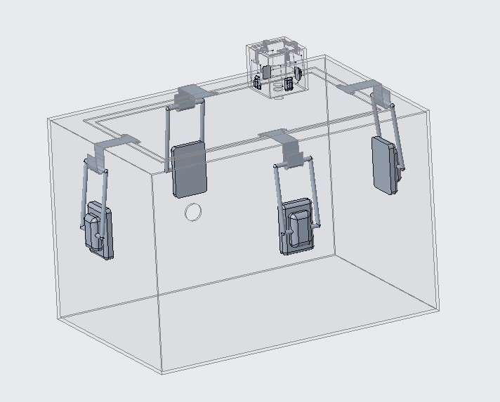
Thank You!
Floor is open for any questions or feedback!
Kendall Kovacs
Notes:
Thank you all so much for your time today. That completes our presentation and the floor is now open for any questions or feedback you all may have.

